Slide 1

Python Machine Learning: KNN
Žydrūnė Kelpšaitė
Data Analyst

Slide 2
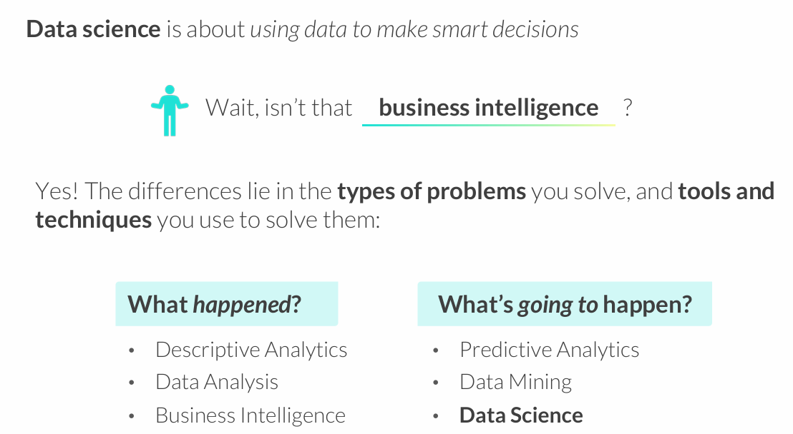
WHAT IS DATA SCIENCE?

Slide 3
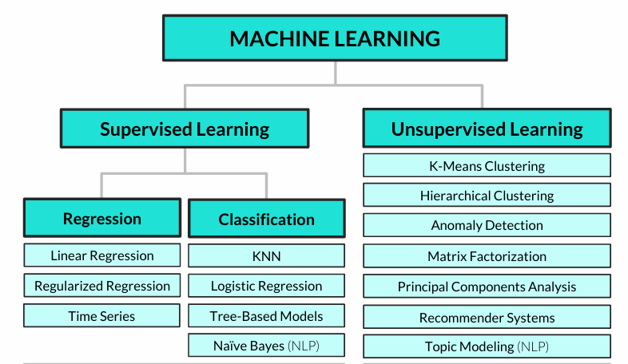
Common machine learning algorithms

Slide 4
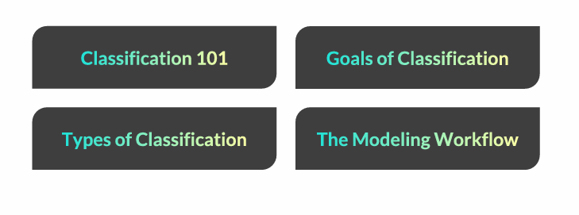
CLASSIFICATION 101

Slide 5
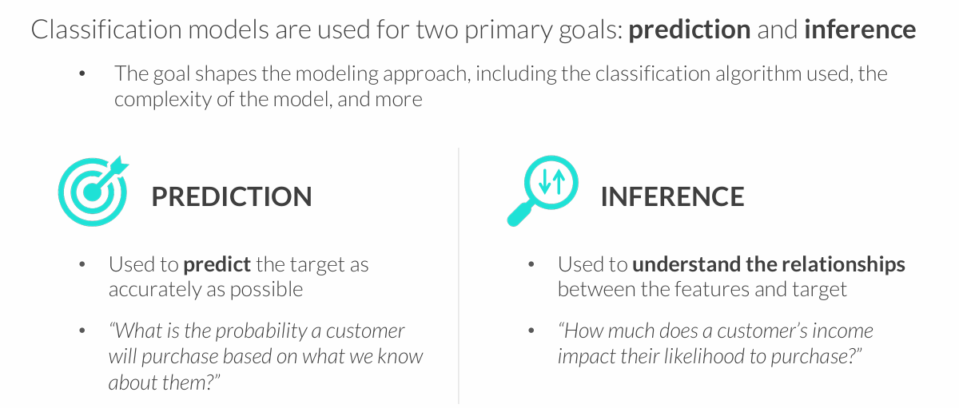
GOALS OF CLASSIFICATION
You often need to strike a balance between these goals – a model that is very inaccurate won’t be too trustworthy for inference, and understanding the impact that variables have on predictions can help make them more accurate

Slide 6
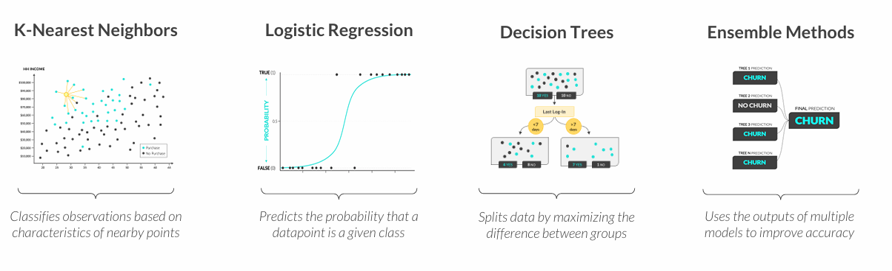
TYPES OF CLASSIFICATION
These are some of the most common types of classification modeling techniques:
All models are wrong, but some are useful
George Box

Slide 7
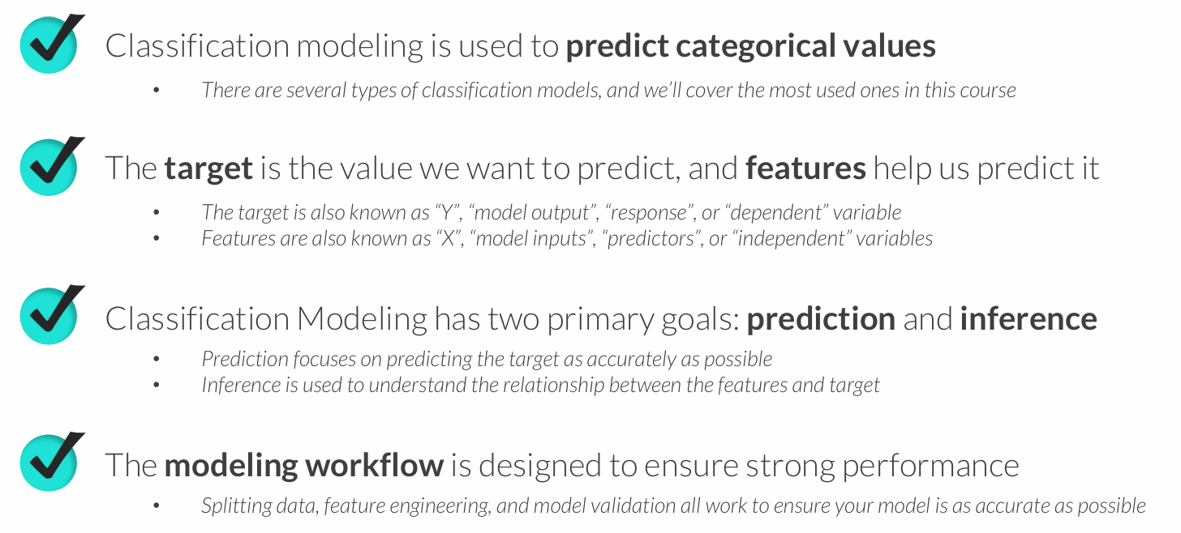
KEY TAKEAWAYS

Slide 8
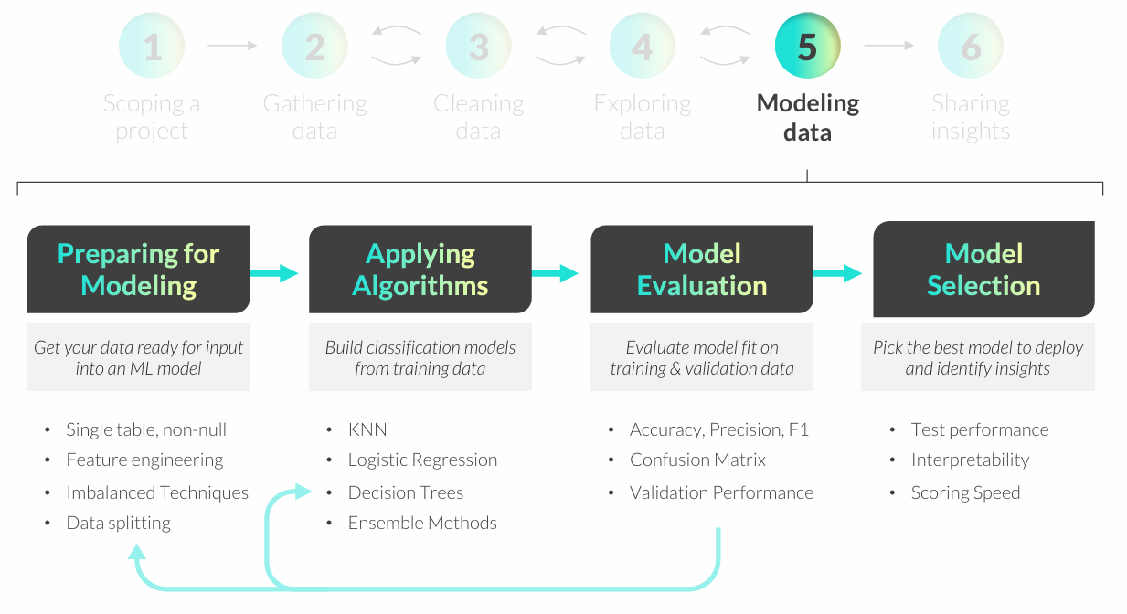
CLASSIFICATION MODELING WORKFLOW

Slide 9
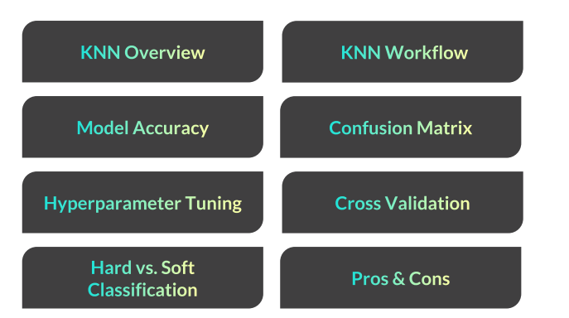
K-NEAREST NEIGHBORS

Slide 10
K-NEAREST NEIGHBORS (KNN)
K-Nearest Neighbors (KNN) is a classification technique designed to predict outcomes based on similar observed values
• In its simplest form, KNN creates a scatter plot with training data, plots a new unobserved value, and assigns a target class based on the classes of nearby points
• K represents the number of nearby points (or “neighbors”) the model will consider when making a prediction
Example use cases:
• Predicting which customers will purchase a product based on demographics
• Classifying customers into pre-existing clusters or segments

Slide 11
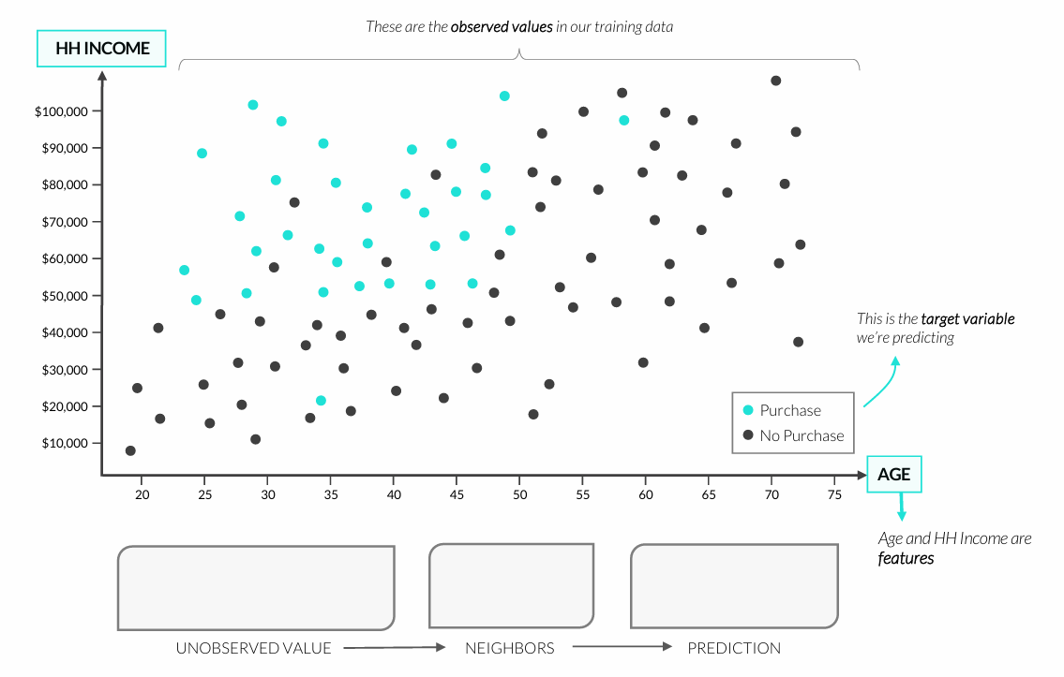
K-NEAREST NEIGHBORS (KNN)

Slide 12
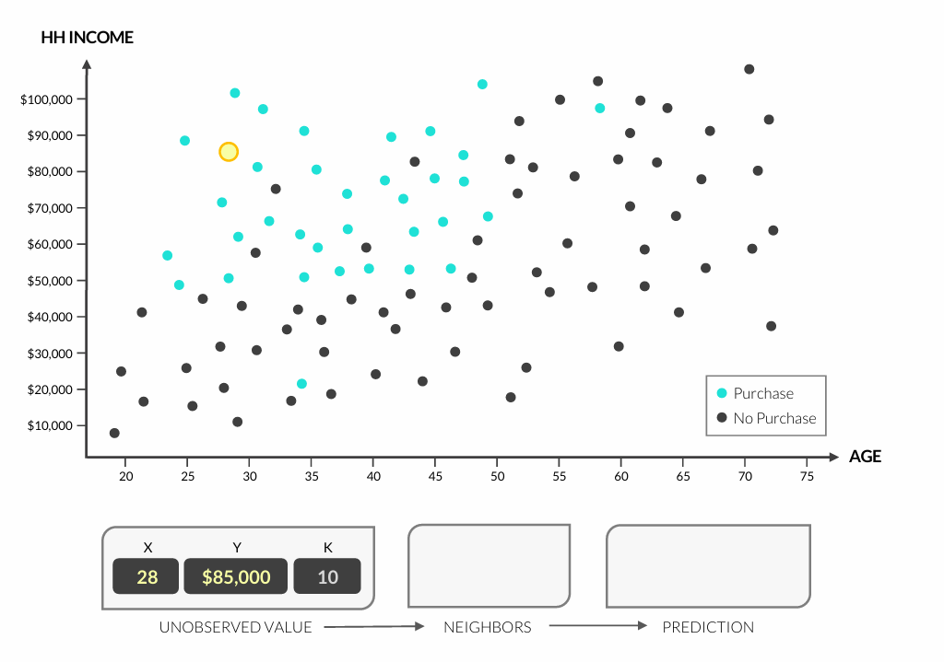
K-NEAREST NEIGHBORS (KNN)

Slide 13
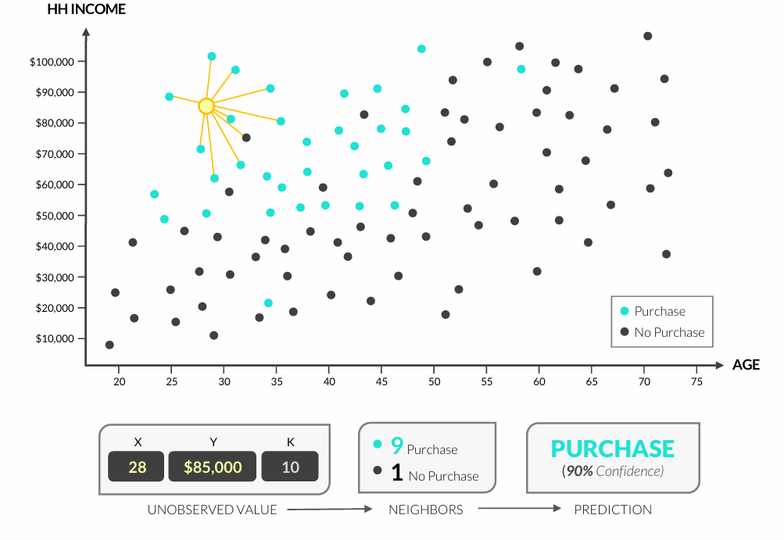
K-NEAREST NEIGHBORS (KNN)

Slide 14
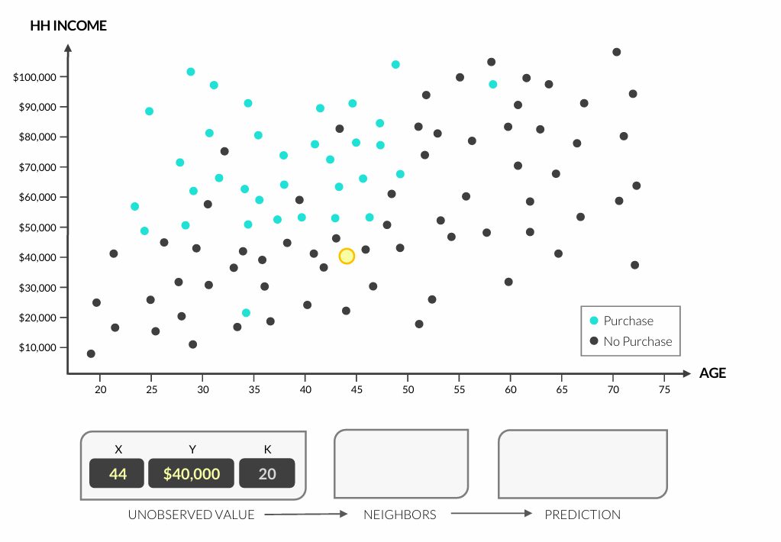
K-NEAREST NEIGHBORS (KNN)

Slide 15
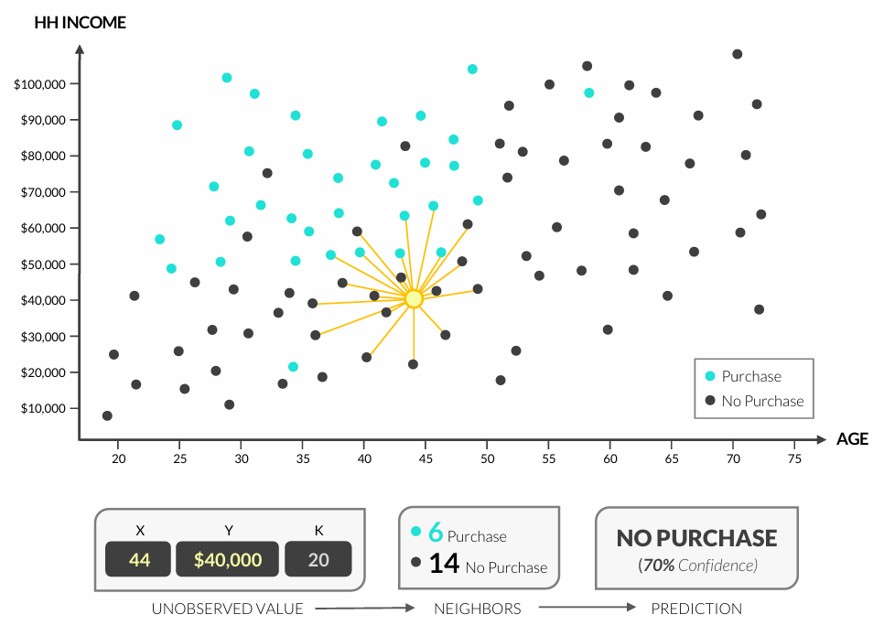
K-NEAREST NEIGHBORS (KNN)

Slide 16
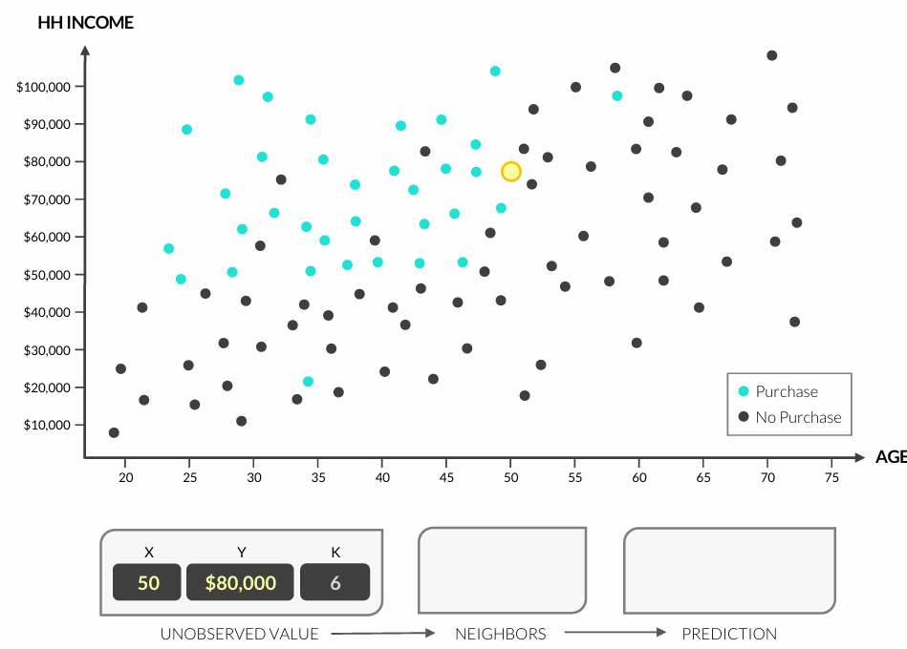
K-NEAREST NEIGHBORS (KNN)

Slide 17
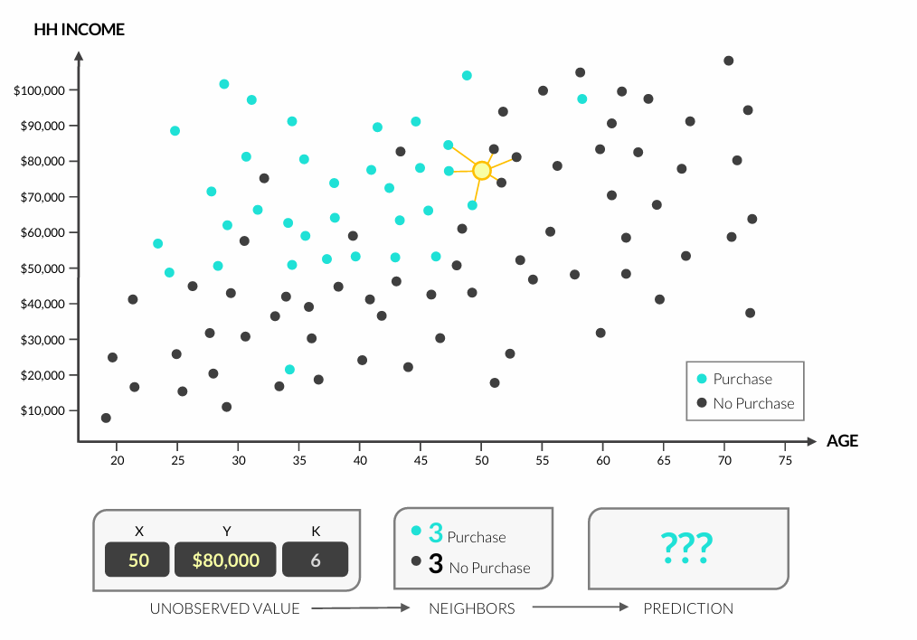
K-NEAREST NEIGHBORS (KNN)

Slide 18
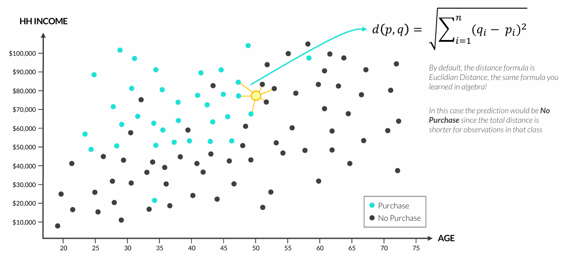
K-NEAREST NEIGHBORS (KNN)
What if there’s a tie?
• In practice, KNN also factors distance between neighbors; if there are multiple modes, the class with the shortest total distance to the observation wins

Slide 19
K-NEAREST NEIGHBORS (KNN)
What if there’s a tie?
• In practice, KNN also factors distance between neighbors; if there are multiple modes, the class with the shortest total distance to the observation wins
How do we figure out the “right” value for K?
• This is where model validation comes in! We will train our model on multiple K values to see which one is most accurate when applied to your validation data
What if we have more than 2 features?
• Scatter plots are great for demonstrating how KNN works for 2 features, but humans can’t visualize beyond 3 or 4 dimensions
• ML algorithms can easily apply the same underlying logic and calculations to many features.

Slide 20
KNN WORKFLOW
Follow the KNN workflow below to ensure that you fit an accurate model:
Split training and test datasets to accurately assess model performance
Scale or standardize the data to make sure all features are weighted equally
Fit & Tune the model by adding or removing features and adjusting k
Score the model on the test data after fitting your final model on the combined training & validation sets

Slide 21
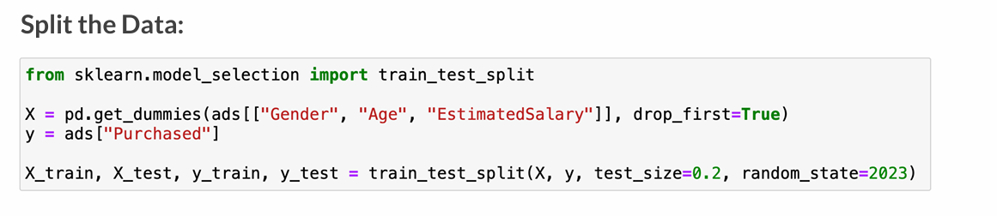
DATA SPLITTING
Before fitting any model, it’s important to split off a test data set
• sklearn.model_selection.train_test_split(X, y, test_size, random_state)

Slide 22
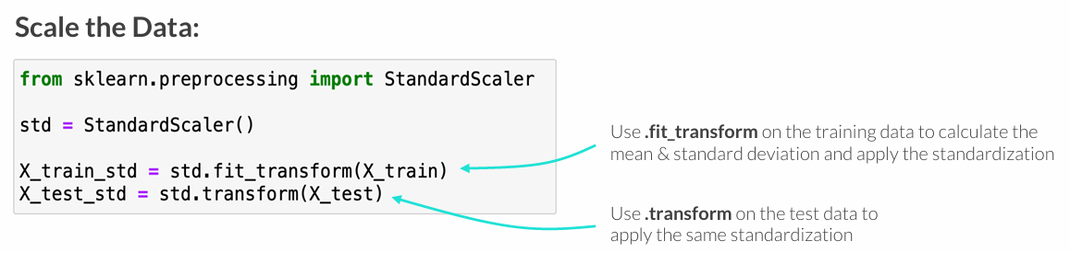
DATA SCALING
Scaling or standardizing your data is necessary for kNN to ensure that features have an equal unit scale (this is critical for distance-based models!)
• sklearn.preprocessing.StandardScaler()

Slide 23
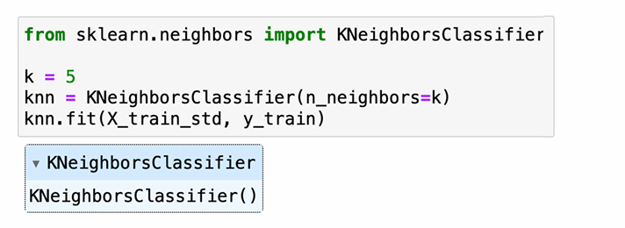
FITTING A KNN MODEL
In Python, you can fit a kNN model using the scikit-learn library
• Remember, data must be split and scaled prior to modeling!
• sklearn.neighbors.KNeighborsClassifier(n_neighbors=k).fit(X, y)
While we’re manually specifying k here, in practice you’ll use cross-validation to determine the optimal value of k

Slide 24
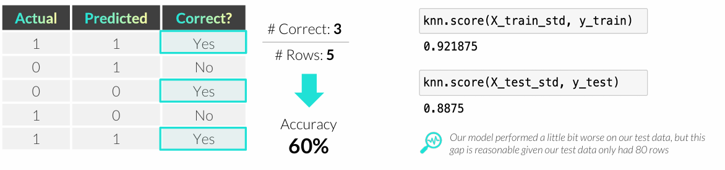
MODEL ACCURACY
Accuracy represents the number of observations predicted correctly divided the total number of observations
• Fitted sklearn models have a .score() method (model.score(X, y) which returns the accuracy score for any feature/target pair
Accuracy isn’t always a useful metric, depending on project goals.

Slide 25
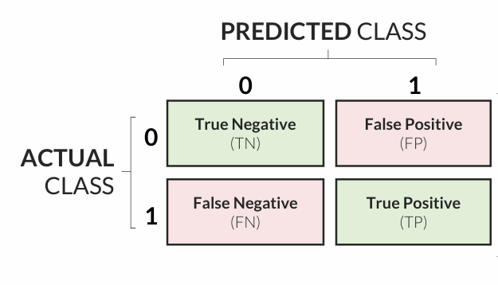
THE CONFUSION MATRIX
The confusion matrix summarizes predicted vs. actual classes, and can be used for summarizing model performance and diagnosing inaccurate predictions
• Metrics like accuracy, precision and recall (more later!) can all be derived from this matrix
Accuracy can be calculated by summing the values in the diagonal (green) divided by the total of all squares
Notes:
Skaičiavimai:
Accuracy = (TP + TN) / (TP + TN + FP + FN)
Precision = TP / (TP + FP)
Recall = TP / (TP + FN)

Slide 26
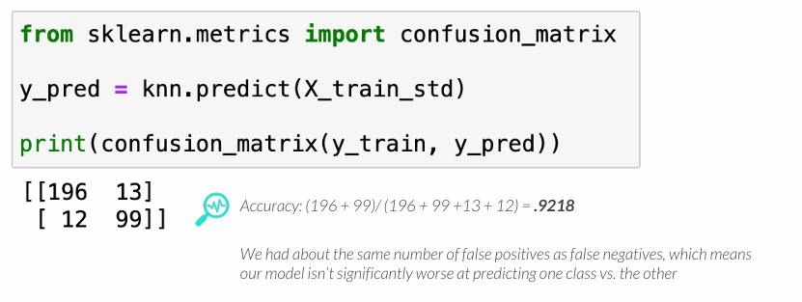
THE CONFUSION MATRIX
The confusion matrix summarizes predicted vs. actual classes, and can be used for summarizing model performance and diagnosing inaccurate predictions
• model.predict(X) returns class predictions from a given feature dataset
• Sklearn.metrics.confusion_matrix(actual_y, predicted_y)

Slide 27
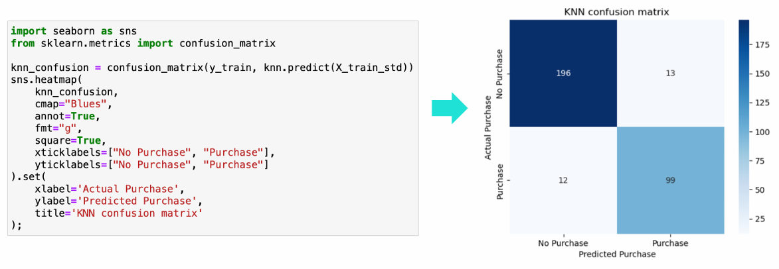
PRO TIP: CONFUSION MATRIX HEATMAP
Seaborn’s heatmap function can be used to make a visual confusion matrix
• sns.heatmap(confusion_matrix(actual, predicted))

Slide 28
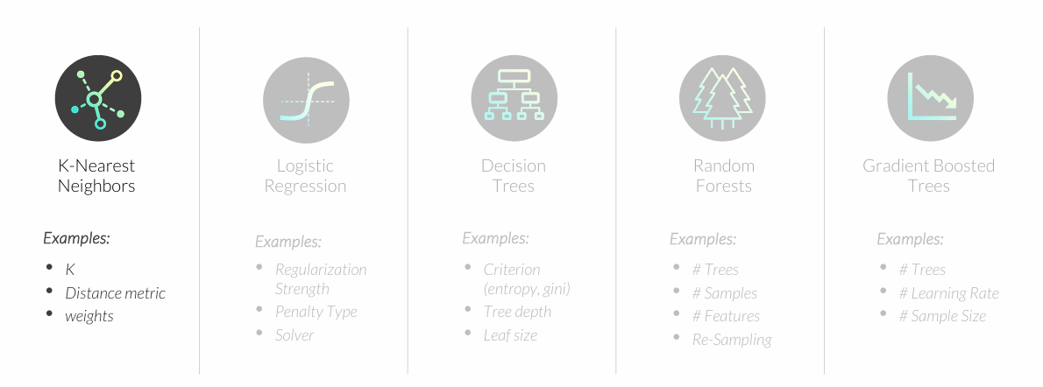
HYPERPARAMETER TUNING
Hyperparameters are settings that affect how well a model fits the data
• Unlike model parameters (like regression coefficients) these are not learned from the data
• Parameters are set before the model is fit and optimized based on validation performance

Slide 29
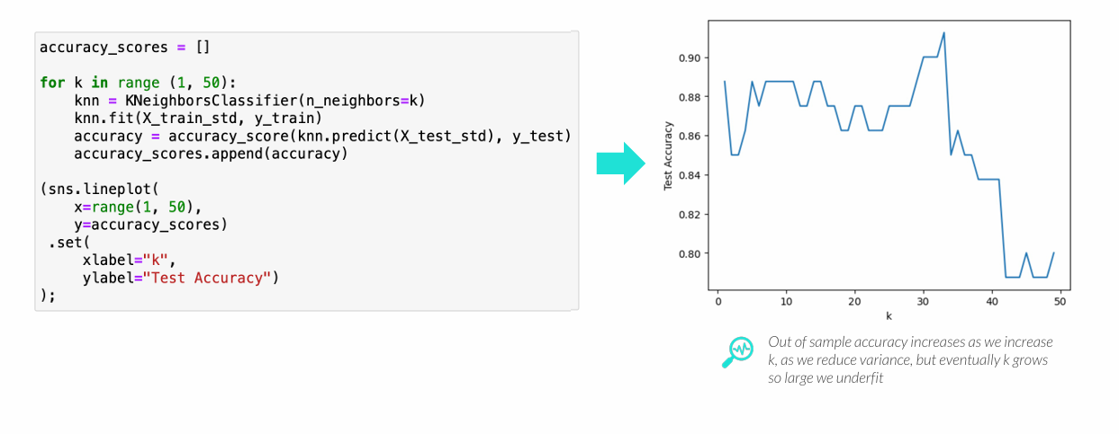
OPTIMIZING K
The optimal value of k can be determined via model validation
• k is bounded between 1 and n, where n is the number of rows in a dataset
• High values of k will tend to underfit, and low values of k tend to overfit

Slide 30
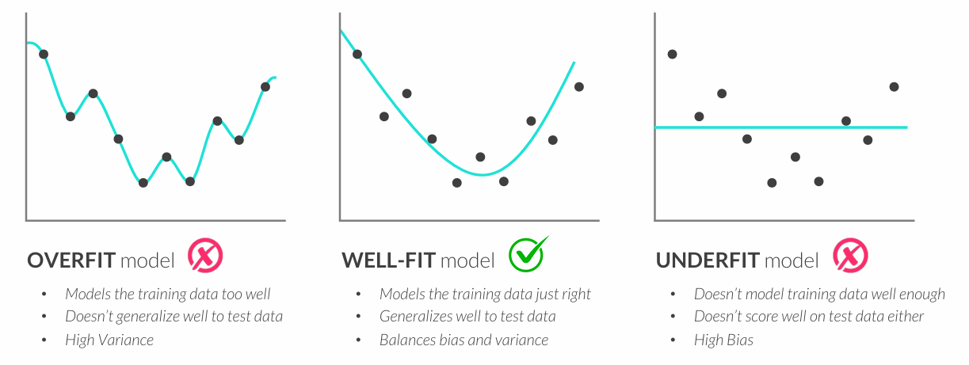
OVERFITTING & UNDERFITTING
Data splitting is primarily used to avoid overfitting, which is when a model predicts known (Training) data very well but unknown (Test) data poorly
• Overfitting is like memorizing test answers instead of learning the material; you’ll ace the test, but lack the ability to generalize and apply your knowledge to unfamiliar questions

Slide 31
OVERFITTING & UNDERFITTING
You can diagnose overfit & underfit models by comparing evaluation metrics like Accuracy, Precision, and Recall between the train and test data sets
• Large gaps between train & test scores indicate that a model is overfitting the data
• Poor results across both train & test scores indicate that a model is underfitting the data
You can fix overfit models by:
• Simplifying the model
• Removing features
• Regularization (more later!)
You can fix underfit models by:
• Making the model more complex
• Adding new features
• Feature engineering
Models will usually have lower performance on test data compared to the performance on training data, so small gaps are expected – remember that no model is perfect!

Slide 32
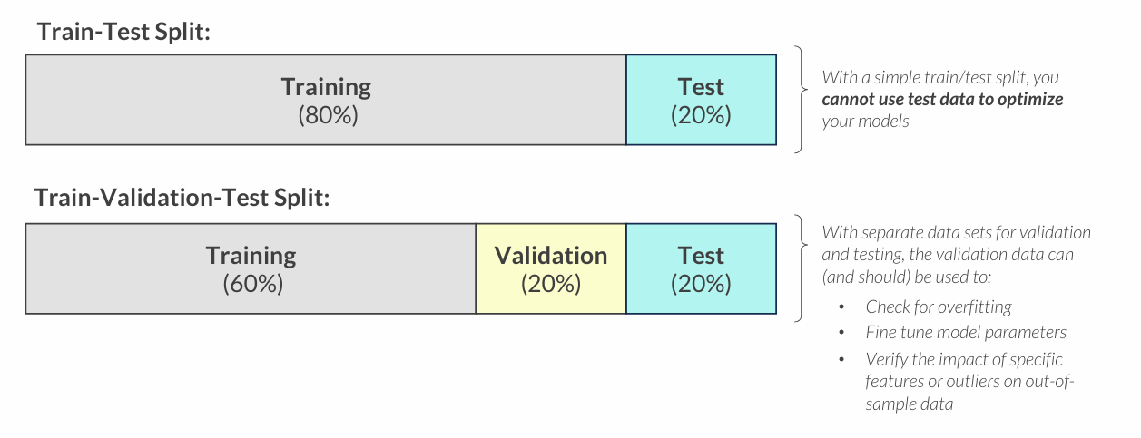
VALIDATION DATA
Validation data is a subset of the training data set that is used to assess model fit and provide feedback to the modeling process
• This is an extension of a simple train-test split of the data

Slide 33
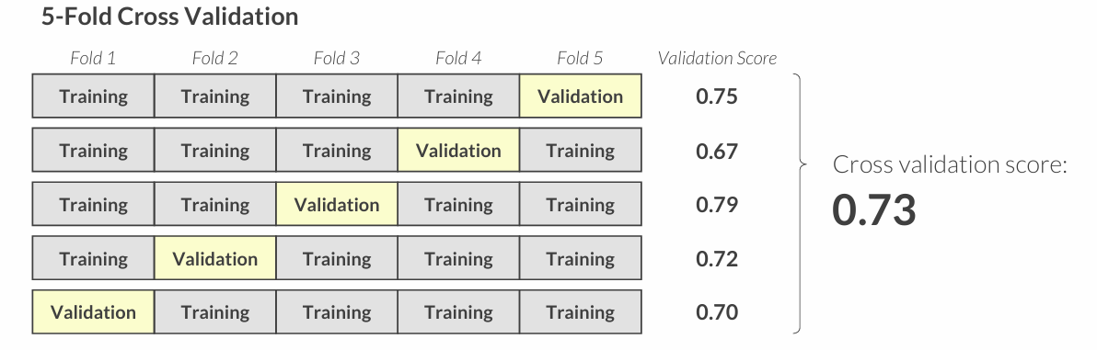
CROSS VALIDATION
Cross validation is another validation method that splits, or “folds”, the training data into k parts, and treats each part as the validation data across iterations
• You fit the model k times on the training folds, while validating on a different fold each time
• This is the preferred method for tuning hyperparameters in scikit-learn

Slide 34
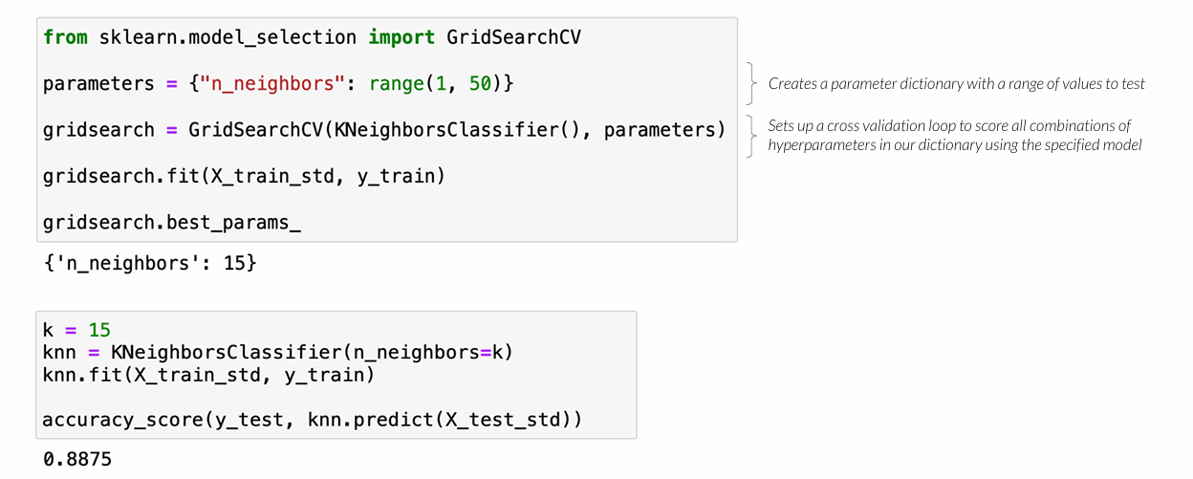
CROSS VALIDATION
Cross validation tends to yield the best out of sample performance
• GridSearchCV(model, parameters) can be used for tuning model hyperparameters

Slide 35
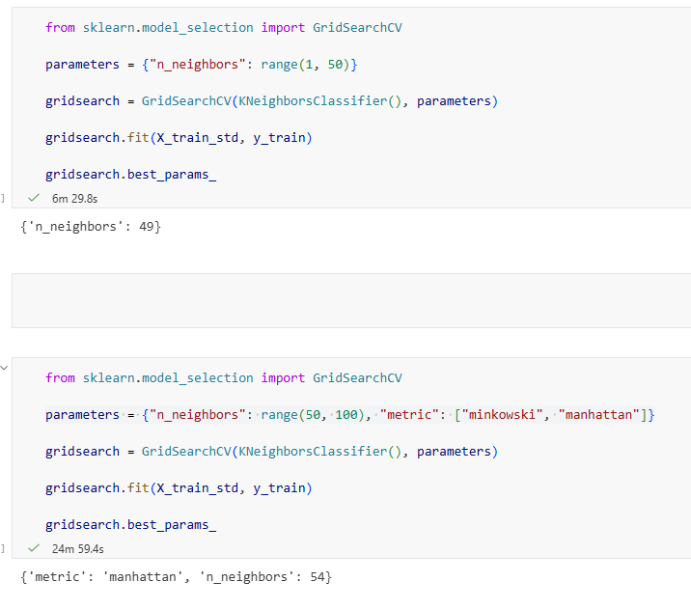
metric nurodo, kaip skaičiuojamas atstumas tarp objektų, o tai tiesiogiai lemia, kurie kaimynai laikomi „artimiausiais“.
Minkowski Bendra atstumo formulė, kuri apjungia kelias metrikas. Priklausomai nuo parametro p, ji tampa:
p = 2 → Euklido atstumas
p = 1 → Manhattan atstumas
Verslo prasmė: Tai lanksti, universali metrika, tinkanti daugeliui situacijų, kai požymiai yra tolygūs ir gerai išskalinti.
Manhattan Atstumas skaičiuojamas kaip absoliučių skirtumų suma kiekviename požymyje.
Intuicija: Judama „žingsniais per ašis“, o ne tiesiai.
Verslo pavyzdys: Klientų palyginimas pagal amžiaus, pajamų ir aktyvumo bendrą skirtumą, o ne „tiesią liniją“.
Kodėl verta testuoti abi Skirtingos metrikos gali duoti skirtingus kaimynus, net su tais pačiais duomenimis.
Verslo prasmė: Pasirenkama ta atstumo logika, kuri geriausiai atspindi realų panašumą tarp klientų, o ne matematiškai „gražiausią“ variantą.

Slide 36
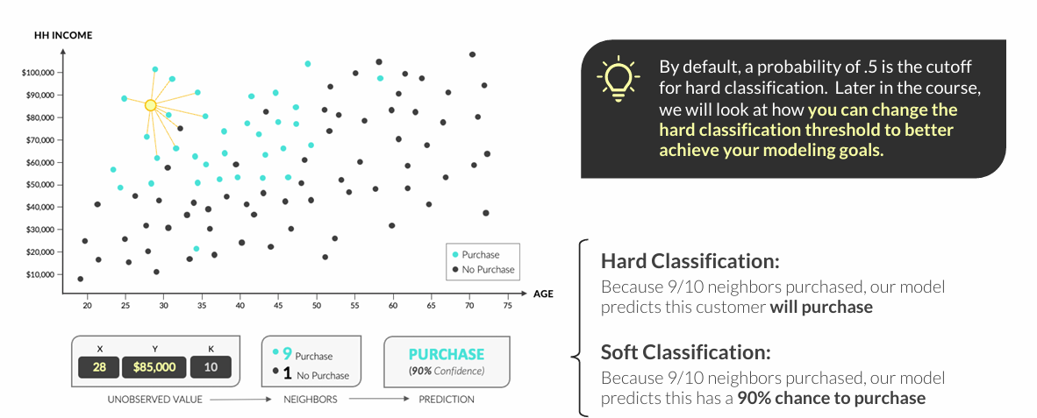
“HARD” VS. “SOFT” CLASSIFICATION
Classification models can produce both “hard” and “soft” classification scores
• “Hard” classification produces the predicted class (e.g. Class A or Class B)
• “Soft” classification produces probabilities of being a given class

Slide 37
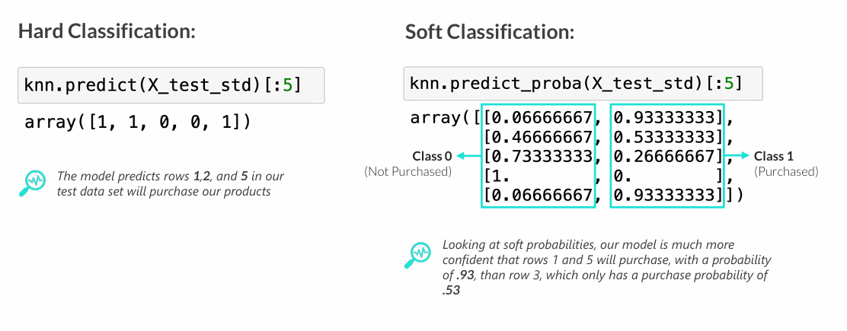
“HARD” VS. “SOFT” CLASSIFICATION
Classification models can produce both “hard” and “soft” classification scores
• model.predict(data) produces hard classifications for a feature dataset
• model.predict_proba(data) produces soft classification scores

Slide 38
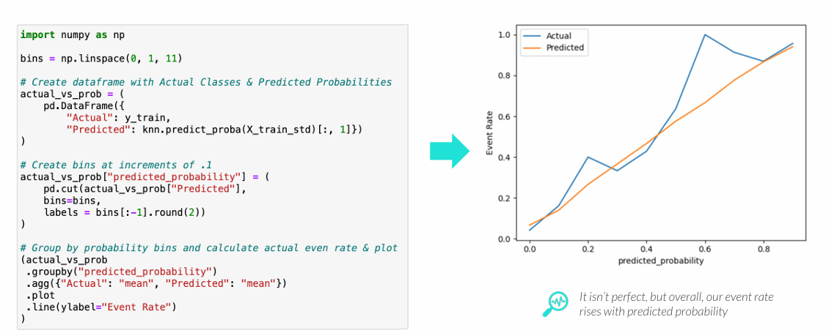
PROBABILITY VS. EVENT RATE
Plotting predicted probabilities vs. observed event rates give us a visual estimation of “soft” classification performance
• We plot the predicted probability vs. average the positive class occurs in each bin
• Ideally our predicted probabilities align closely with our event rate

Slide 39
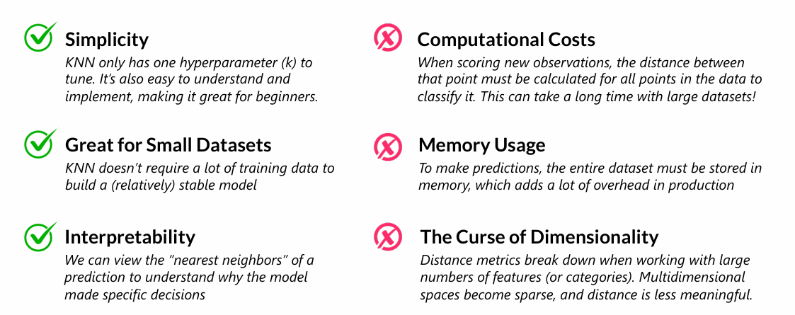
PROS & CONS OF KNN
KNN has some pros and cons that data scientists should be aware of when deciding whether it is the best model for the task at hand
• In general, KNN is a great choice for smaller datasets, but faces severe performance drawbacks when working with larger, more complex data

Slide 40
KEY TAKEAWAYS
* KNN is a distance-based algorithm that classifies points based on the classes of nearby data points
• Euclidean distance is used to calculate the distance between points
* The hyperparameter “k” specifies how many neighbors get a vote
• The value of k can be tuned via cross-validation techniques
* Accuracy measures how many points were classified correctly
• The confusion matrix gives us more detail about what our model got right, and where it misclassified data
* KNN (like all models) has pros and cons that should be considered
• KNN is great for prototypes and small datasets, but struggles with larger, more complex data

